Slide 1
Information Processing Techniques
Lecture 1 | Week 1

Slide 2
Marks Distribution
Assignments: 10
Project: 12
Mid-term: 25
Labs: 3
Finals: 50

Slide 3
Plagiarism Policy
Partial marks will be given in case of incomplete submissions. However, if any plagiarism is found, you will be marked ZERO in the assignment

Slide 4
Reference Books
Pro C# 7 With .Net and .Net Core by Andrew Troelsen and Philip Japikse (Apress Publications)

Slide 5
Pre-requisite
Knowledge of programming
Knowledge of data structures
Knowledge of database server and queries
Honesty & dedication

Slide 6
Required Tools
Visual Studio (VS 2017/2019/Code)
Windows Application
Windows Service
Web Application (ASP.Net)
Web Service (ASMX)
WCF
WEB API
SQL Server ( SQL Server 2014+ Professional or Enterprise Edition)

Slide 7
Information Processing Techniques
Using technology effectively under given situation and constraints
Making use of the tools and technologies to process the information efficiently
Examples:
Choosing Sorting Algorithm
Choosing Data Base , choosing types of join
Choosing different Web Service v/s WCF v/s Web API

Slide 8
.NET Framework
.NET framework is an environment (set of technologies) that allows the development of applications
VS.NET is the set of tools that exploits the .NET framework

Slide 9
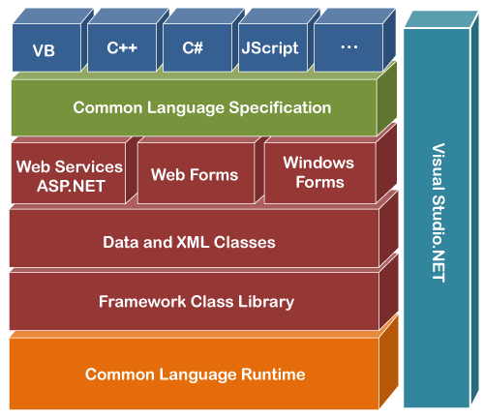
.NET Framework

Slide 10
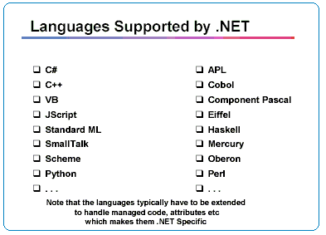
.NET Languages
.NET framework supports about 60+ programming languages including C#, VB, F#, APL, C++/CLI

Slide 11
Framework Class Library
The Framework Class Library or Base Class Library provides a library of clean, reusable code that developers can use to build their applications
ASP.NET provides the core Web infrastructure such as Web Forms for UI based development Example: System.Web.UI.Page
It also provides Web Services for programmatic interface development
UI development on Windows platform can be done using Windows Forms
ADO.NET and XML provide the functionality for data access

Slide 12
Common Language Runtime (CLR)
The Common Language Runtime is the component that executes all the programs written on the .NET Framework. It offers several services, including:
Memory management, code execution and threads, basic security checks
Performing type-safety
Garbage collection, i.e. removing unwanted resources
Common Intermediate Language (CIL) for interoperability between .NET languages
Generating native code from CIL
Hosting runtime on server-side applications (e.g. MS SQL Server)

Slide 13
Common Language Runtime (CLR) Components
Common Language Runtime (CLR)
Common Language Infrastructure (CLI)
Garbage Collector
JIT (just in time) compilation
Common Type System (CTS)
Common Language Specification (CLS)

Slide 14
Common Type System (CTS)
The CTS specification fully describes all possible data types, operations and programming constructs supported by the .NET runtime
Example
- In C#, an integer variable can be declared as: int k;
- In J#, the declaration would be: Dim k As Integer
But both these languages have common
CTS data type: System.Int32

Slide 15
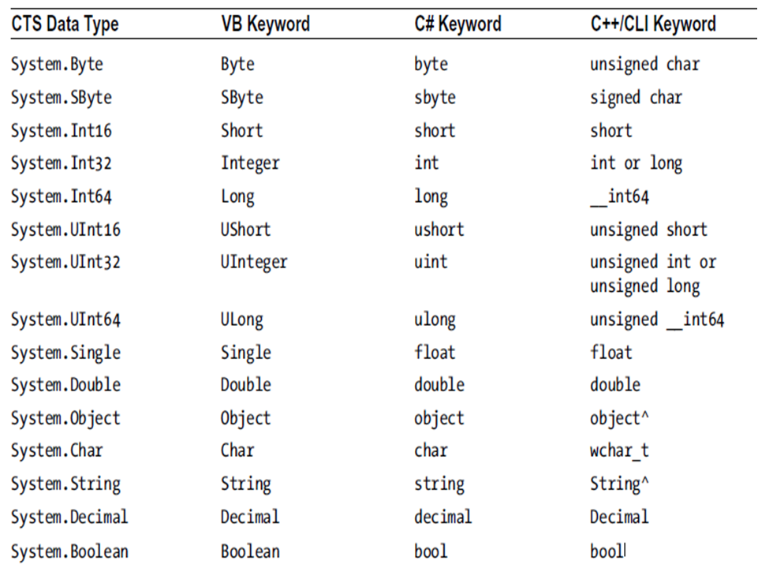

Slide 16
Common Language Specification (CLS)
Different .NET languages have their own programming constructs and syntax
The CLS is a set of rules that describe the restrictions all .NET languages must follow in order to generate CIL
The languages conforming to these rules are called CLS-compliant languages
Example: .NET does not inherently support Multiple Inheritance

Slide 17
Just In Time (JIT) Compilation
Each .NET language compiler produces an intermediate code after compiling the source code. The intermediate code is common for all languages and is understandable only to .NET environment
This intermediate code or CIL is called Microsoft Intermediate Language (MSIL)
The MSIL is converted to Native Machine Code by JIT

Slide 18
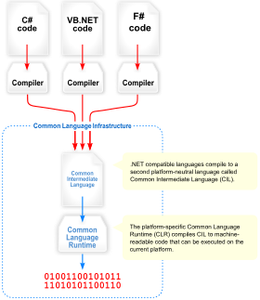
Visual Overview of CLI

Slide 19
Visual Overview of CLI

Slide 20
Benefits of CIL (MSIL)
Why do we need CIL rather then directly converting to a specific instruction set?
Language integration: Each .NET-aware compiler produces nearly identical CIL instructions. Therefore, all languages are able to interact within a well-defined binary arena.
Platform-agnostic: a single codebase running on numerous operating systems.

Slide 21
.NET Assemblies
When a *.dll or *.exe has been created using a .NET-aware compiler, the binary blob is termed an assembly
Assemblies contain:
MSIL (Microsoft Intermediate Language)
Resources
Metadata
Manifest

Slide 22
Types of Assemblies
Assemblies are basically the following two types:
Private Assembly:
Assembly that is being used by a single application only
Shared Assembly
Assemblies that can be used in more than one project and installed in Global Assembly Cache (GAC)

Slide 23
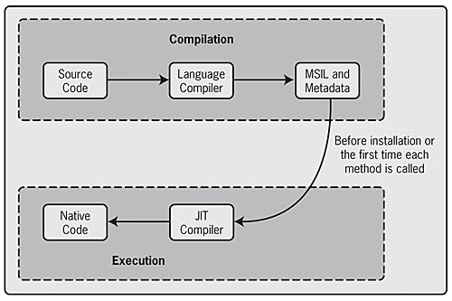
MSIL to Native Code

Slide 24
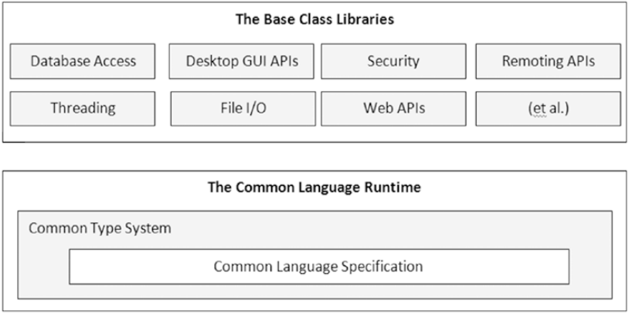
Relationship Between Base Class Library, CLR, CLS, CTS

